Slide 1
Analyzing Systems Using Data Dictionaries
8
Systems Analysis and Design, 8e
Kendall & Kendall

Slide 2
Cataloging
Data flow diagrams can be used to catalog:
Data processes
Flows
Stores
Structures
Elements
Cataloging takes place with the data dictionary
Notes:
The data dictionary is another method to aid in the analysis of data-oriented systems.
Using a top-down approach, the systems analyst uses data flow diagrams to begin compiling a data dictionary.

Slide 3
The Data Dictionary
A reference work of data about data (metadata)
Collects and coordinates data terms, and confirms what each term means to different people in the organization
Notes:
One reason to maintain a data dictionary is to keep consistent data.
Automated data dictionaries allow for the cross referencing of data items, allowing necessary program changes to all programs sharing a common element.

Slide 4
Need for Understanding the Data Dictionary
Provide documentation.
Eliminate redundancy.
Validate the data flow diagram.
Provide a starting point for developing screens and reports.
Determine the contents of data stored in files.
To develop the logic for DFD processes.
Create XML.
Notes:
Understanding what data compose a data dictionary, the conventions used in data dictionaries, and how a data dictionary is developed, are issues that remain pertinent for the system analyst during the systems effort.

Slide 5
The Data Repository
A data repository is a large collection of project information.
It includes:
Information about the data maintained by the system
Procedural logic and use cases
Screen and report design
Data relationships
Project requirements and final system deliverables
Project management information
Notes:
The data dictionary contains information about data and procedures; the repository is a larger collection of project information.
Information about the data maintained by the system – data flows, data stores, record structures,, elements, entities, and messages.
Project management information – delivery schedules, achievements, issues that need resolving, project users.

Slide 6
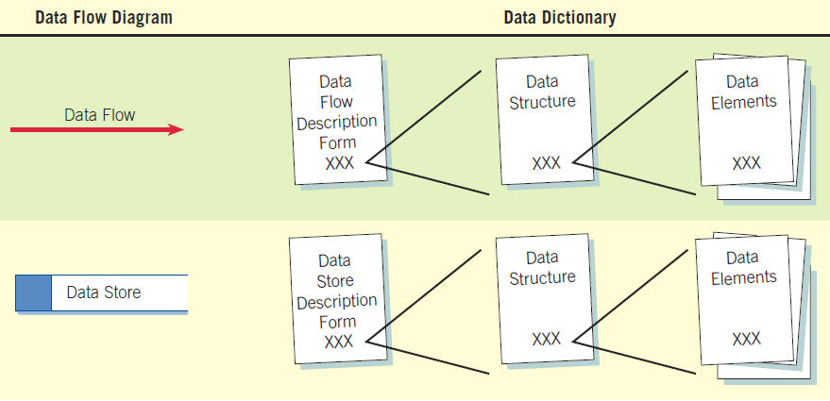
How Data Dictionaries Relate to Data Flow Diagrams
Notes:
The data dictionary is created by examining and describing the contents of the data flows, data stores, and processes.

Slide 7
Data Dictionary Categories
Data flows
Data structures
Elements
Data stores
Notes:
The four data dictionary categories should be developed to promote understanding of the data of the system.

Slide 8
An Example of a Data Flow Description from World’s Trend Catalog Division
Notes:
Represents the screen used to add a new CUSTOMER ORDER and to update the customer and item files.

Slide 9
Describing Data Structures
Data structures are made up of smaller structures and elements.
An algebraic notation is used to describe data structures.
Notes:
A record structure would be an example of a data structure.

Slide 10
Algebraic Notation
Equal sign =, meaning “is composed of”
Plus sign +, meaning “and”
Braces {} meaning repetitive elements
Brackets [] for an either/or situation
Parentheses () for an optional element
Notes:
Repetitive elements are also called repeating groups or tables.
Brackets – the elements listed between the brackets are mutually exclusive.
Parentheses – optional elements may be left blank on entry screens and may contain spaces or zeros for numeric fields in file structures.

Slide 11
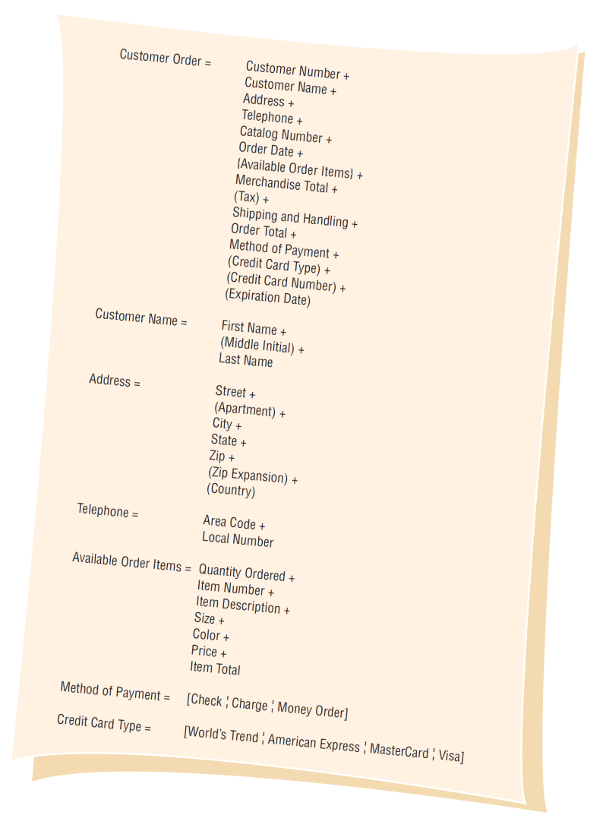
Data Structure Example for Adding a Customer Order at World’s Trend Catalog Division

Slide 12
Structural Records
A structure may consist of elements or structural records.
These are a group of elements, such as:
Customer name
Address
Telephone
Each of these must be further defined until they are broken down into their component elements.
Notes:
A structural record is made up of a group of element. Customer Name is made up of First Name, Middle Name, Last Name.

Slide 13
Structural Records Used in Different Systems
Structural records and elements that are used within many different systems are given a non-system-specific name, such as street, city, and zip/area code.
The names do not reflect a functional area.
This allows the analyst to define them once and use in many different applications.
Notes:
For example, City may be a customer city, supplier city, or employee city.

Slide 14
Structural Record Example
Notes:
Customer name, address, and telephone are groups of elements or structural records.

Slide 15
Logical and Physical Data Structures
Logical:
Show what data the business needs for its day-to-day operations.
Physical:
Include additional elements necessary for implementing the system.
Notes:
It is important that the logical design accurately reflect the mental model of how the user views the system.
The physical data structures are designed using the logical data structures as a basis.

Slide 16

An Element Description Form Example from World’s Trend Catalog Division
Notes:
Defined once in the data dictionary

Slide 17
Element ID
Optional entry
Allows the analyst to build automated data dictionary entries

Slide 18
The Name of the Element
Should be:
Descriptive
Unique
Based on what the element is commonly called in most programs or by the major user of the element

Slide 19
Aliases
Synonyms or other names for the element
Names used by different users in different systems
A CUSTOMER NUMBER may also be called a RECEIVABLE ACCOUNT NUMBER or a CLIENT NUMBER.

Slide 20
Short Description of the Element
An example might be:
Uniquely identifies a customer who has made any business transactions within the last five years

Slide 21
Element Is Base or Derived
A base element is one that has been initially keyed into the system.
A derived element is one that is created by a process, usually as the result of a calculation or a series of decision-making statements.

Slide 22
Element Length
What should the element length be?
Some elements have standard lengths, state abbreviations, zip codes, or telephone numbers.
For other elements, the length may vary and the analyst and user community must decide the final length.

Slide 23
Element Length Considerations
Numeric amount lengths
Name and address fields
Other fields
Notes:
Numeric amount lengths - should be determined by figuring the largest number the amount will contain and then allowing room for expansion.
Totals should be large enough to accommodate the numbers accumulated into them.
Name and address fields – can be determined from a table.
Other fields – look at historical data found in the organization.

Slide 24
Name and Address Length
Percent of data that will
Element Length fit (United States)
Last Name 11 98
First Name 18 95
Company Name 20 95
Street 18 90
City 17 99
Notes:
A name field of 11 characters will accommodate 98 percent of the last names in the United States.

Slide 25
Data Truncation
If the element is too small, the data will be truncated.
The analyst must decide how this will affect the system outputs.
If a last name is truncated, mail would usually still be delivered.
A truncated email address or Web address is not usable.

Slide 26
Type of Data
Alphanumeric or text data
Formats
Mainframe: packed, binary, display
Microcomputer (PC) formats
PC formats, such as Currency, Number, or Scientific, depend on how the data will be used
Notes:
Mainframe: packed, binary, display –
Zoned decimal – used for printing and displaying data
Packed decimal – commonly used to save space on file layouts and for elements that require a high level of arithmetic to be performed on them.
Binary – suitable for the same purposes as the packed decimal format but is less commonly used.

Slide 27
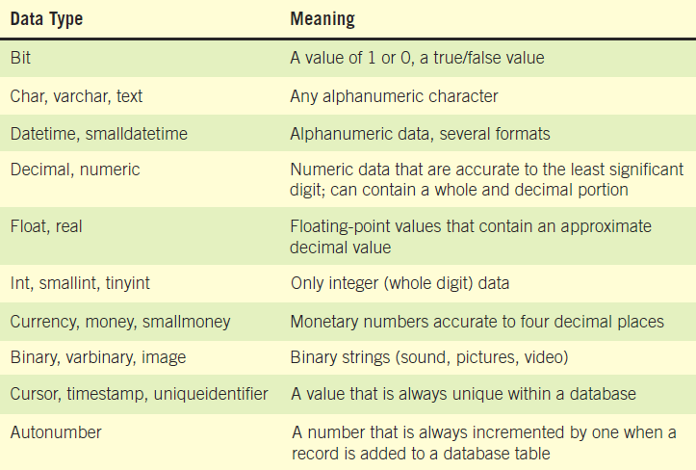
Some Examples of Data Formats Used in PC Systems

Slide 28
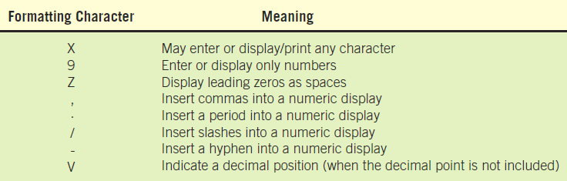
Format Character Codes
Notes:
Input and output formats should be included, using coding symbols:
Z - Zero suppress.
9 – Number.
X – Character.
X(8) - 8 characters.
. , - Comma, decimal point, hyphen.
These may translate into masks used to define database fields.

Slide 29
Validation Criteria
Ensure that accurate data are captured by the system
Elements are either:
Discrete, meaning they have fixed values
Continuous, with a smooth range of values
Notes:
Discrete –
Discrete elements are verified by checking the values within a program.
They may search a table of codes.
Continuous –
Continuous elements are checked that the data is within limits or ranges.

Slide 30
Default Value
Include any default value the element may have
The default value is displayed on entry screens.
Reduces the amount of keying
Default values on GUI screens
Initially display in drop-down lists
Are selected when a group of radio buttons are used

Slide 31
Comment or Remarks Area
This might be used to indicate the format of the date, special validation that is required, the check-digit method used, and so on

Slide 32
Data Stores
Data stores are created for each different data entity being stored.
When data flow base elements are grouped together to form a structural record, a data store is created for each unique structural record.
Because a given data flow may only show part of the collective data that a structural record contains, many different data flow structures may need to be examined to arrive at a complete data store description.
Notes:
Data stores are created for each different data entity being stored - All base elements must be stored in the system. Derived elements may also be stored in the system.

Slide 33
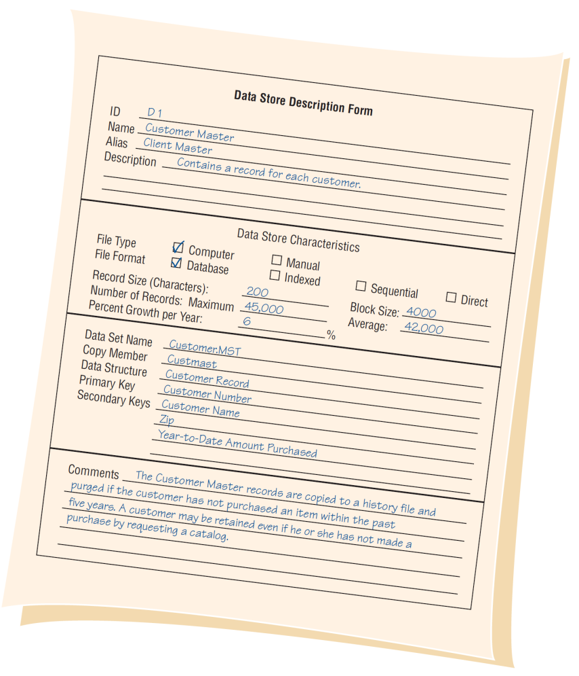
Example of a Data Store Form for World’s Trend Catalog Division

Slide 34
Creating the Data Dictionary
Data dictionary entries
Created after the data flow diagram is completed or
Created as the data flow diagram is being developed
Created using a top-down approach
Notes:
The use of algebraic notation and structural records allows the analyst to develop the data dictionary and the data flow diagrams using a top-down approach.

Slide 35
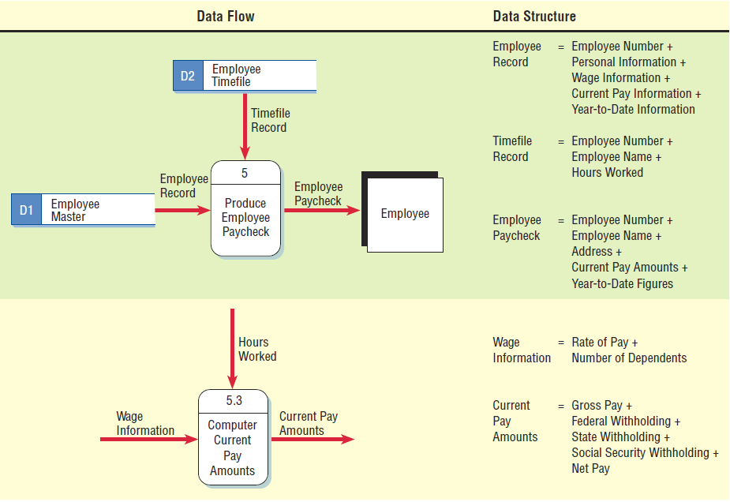
Two Data Flow Diagrams and Corresponding Data Dictionary Entries for Producing an Employee Paycheck
Notes:
It is important that he data flow names on the child data flow diagram are contained as elements or structural records in the data flow on the parent process. i.e. WAGE INFORMATION is a structural record contained in the EMPLOYEE RECORD.

Slide 36
Analyzing Input and Output
A descriptive name for the input or output
The user contact responsible
Whether the data is input or output
The format of the data flow
Elements indicating the sequence of the data on a report or screen
A list of elements
Notes:
An important step in creating the data dictionary is to identify and categorize system input and output data flow.
A descriptive name for the input or output – if the data flow is on a logical diagram, the name should identify what the data are for, if on the physical design the names should include that information regarding the format.
The user contact responsible – for further details clarification, design, feedback, and final approval.
The format of the data flow – in the logical design stage the format may be undetermined.
A list of elements – including their names, lengths, and whether they are base or derived, and their editing criteria.

Slide 37
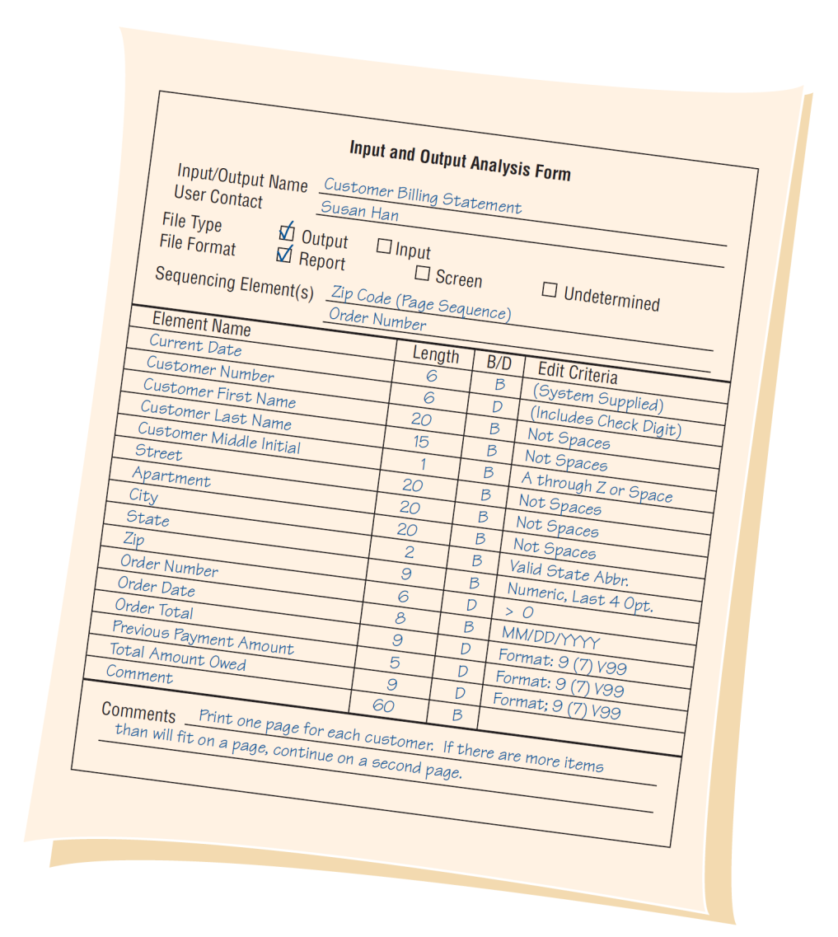
An Example of an Input/Output Analysis Form for World’s Trend Catalog Division
Notes:
Once the forma has been completed, each element should be analyzed to determine whether the element repeats, whether it is optional, or whether it is mutually exclusive of another element.

Slide 38
Developing Data Stores
Represent data at rest (not in motion).
Contain information of a permanent or temporary nature.
When data stores are created for only one report or screen, we refer to them as “user views” = (the way that the user wants to see the information)
Notes:
Derived values do not have to be stored in a data store.
“user views” – the way the user wants to see the information.

Slide 39
Using the Data Dictionary
To have maximum power, the data dictionary should be tied into a number of systems programs.
May be used to
Create screens, reports, and forms
Generate computer language source code
Analyze the system design, detecting flaws and areas that need clarification
Notes:
The ideal data dictionary is automated, interactive, online, and evolutionary.
To have maximum power, the data dictionary should be tied into a number of systems programs – so that when an item is updated or deleted from the data dictionary, it is automatically updated or deleted from the database.

Slide 40
Using Data Dictionaries to Create XML
XML is used to exchange data between businesses.
XML addresses the problem of sharing data when users have different computer systems and software or different database management systems.
XML documents may be transformed into different output formats.
XML is a way to define, sort, filter, and translate data into a universal data language that can be used by anyone.
XML may be created from databases, a form, software programs, or keyed directly into a document, text editor, or XML entry program.
Notes:
XML is used to exchange data between businesses – or between systems within a business.
If everyone used the same software or database management system, there would be no need for XML.
XML document may be transformed into different output formats – printed output, Web pages, output for a handheld device, and PDF files.
XML advantage
The analyst may select only the data that an internal department or external partner needs to have in order to function

Slide 41
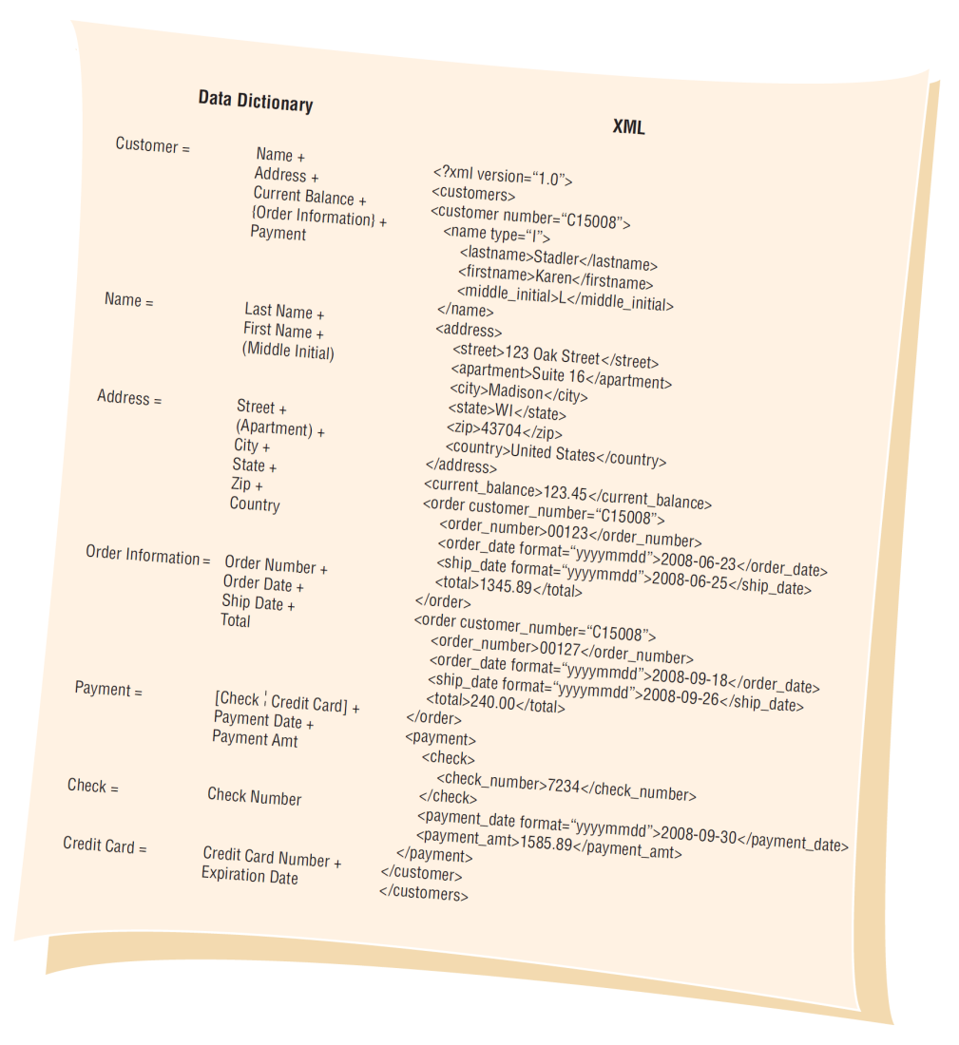
Using a Data Dictionary Entry to Develop XML Content: The XML Document Mirrors the Data Dictionary Structure

Slide 42
Summary
The data dictionary
A reference work containing data about data
Includes all data items from data flow diagrams
Repository
A larger collection of project information
Defining data structures
Defining elements

Slide 43
Summary (Continued)
Defining data stores
Data dictionary entries
Using the data dictionary
Data dictionary analysis
Data dictionary to XML

